Slide 1
React Web Applications Master Class
Styling with React
SoftUni Team
Technical Trainers
Software University
http://softuni.bg

Slide 2



Learn to Search in Internet
The course assignments require to search in Internet
This is an important part of the learning process
Some exercises intentionally have no hints
Learn to find solutions!
Software development includes everyday searching and learning
No excuses, just learn to study!
Developers learn new technologies, tools, languages every day!

Slide 3
Agenda
Basic Concepts
CSS Processors, CSS Methodologies
(S)CSS Stylesheets
(S)CSS Modules
Inline Styling
CSS in JS
Styled Components
React UI Libraries
Reactstrap, Material UI, Rebass

Slide 4
Basic Concepts

Slide 5
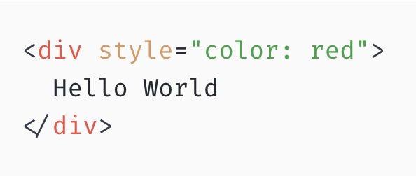
CSS Evolution

Slide 6
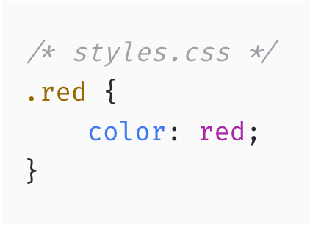
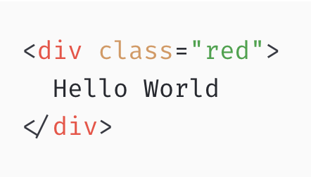
CSS Evolution

Slide 7
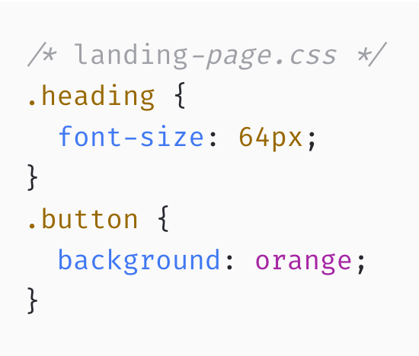
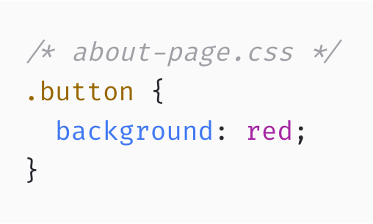
CSS Evolution

Slide 8
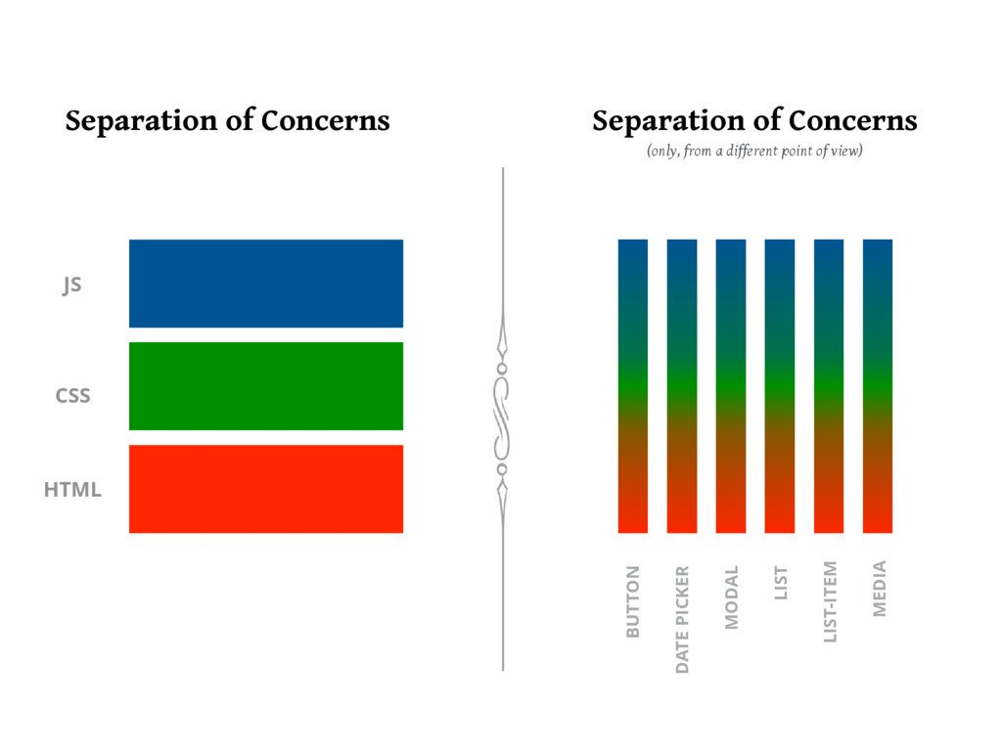
Separation of Concerns

Slide 9
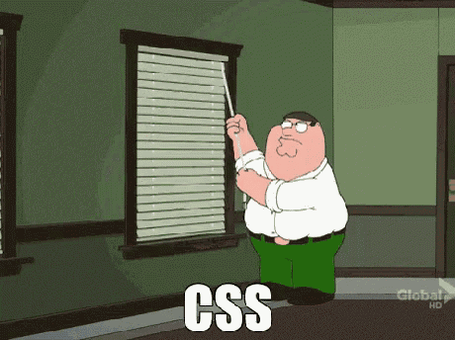

Slide 10
Major Problems with CSS
Maintenance (dead code elimination)
Global namespace
Cascading order
Specificity
Optimizations (minification)
Browser Compatibility
and more...

Slide 11




CSS Methodologies

Slide 12
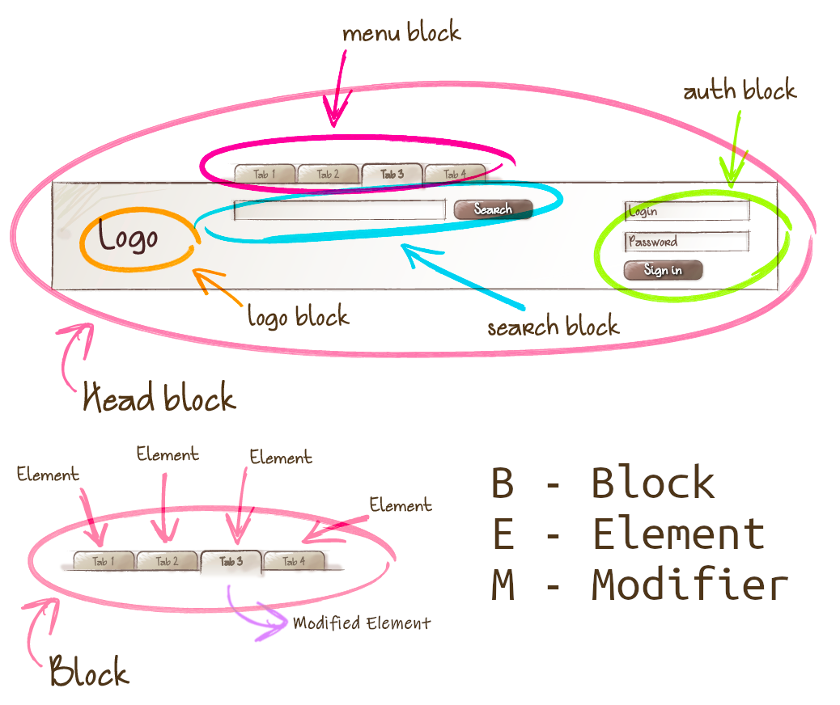
CSS Methodologies - BEM

Slide 13
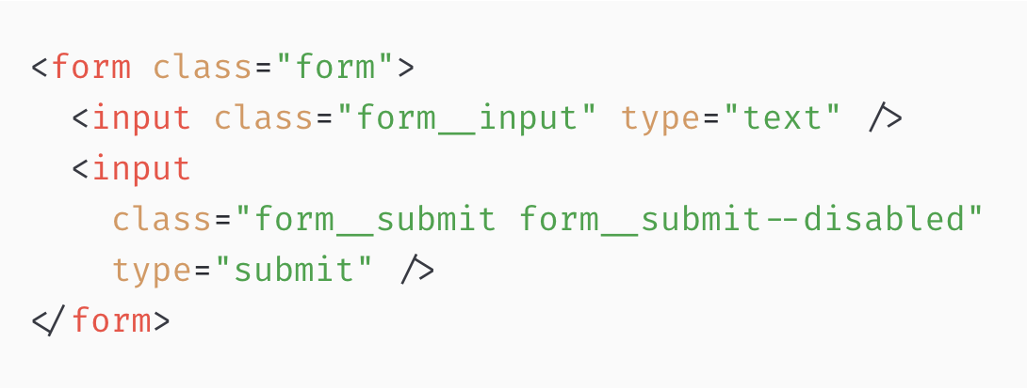
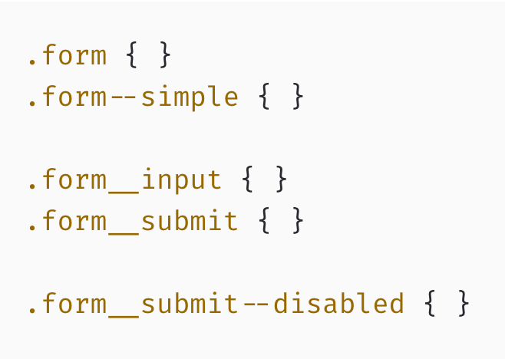
CSS Methodologies - BEM

Slide 14

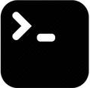

CSS Pre-processing
.scss
.css
compiler

Slide 15

CSS Pre-processing - SASS (SCSS)
SASS adds special features into regular CSS such as:
variables $
nested selectors &
mixins @mixin / @include
functions @function
extend/inheritance @extend
operators / * %
https://sass-lang.com/

Slide 16

CSS Post-processing
super
.css
.css
JS compiler

Slide 17

CSS Post-processing - PostCSS
PostCSS is a tool to transform styles with JS plugins.
autoprefixer - add vendor prefixes (Can I Use)
cssnano - css optimizations
postcss-preset-env - next CSS spec
stylelint
https://postcss.org

Slide 18


Slide 19
CSS Stylesheets
(plain old)

Slide 20
CRA - Under The Hood
webpack plugins - css-loader, style-loader, (sass-loader)
postcss plugins:
autoprefixer
preset-env
normalize (optional)
Hot Module Reload (HMR)
optimized/minified css files in production
separate files for internal and external styles (npm)

Slide 21
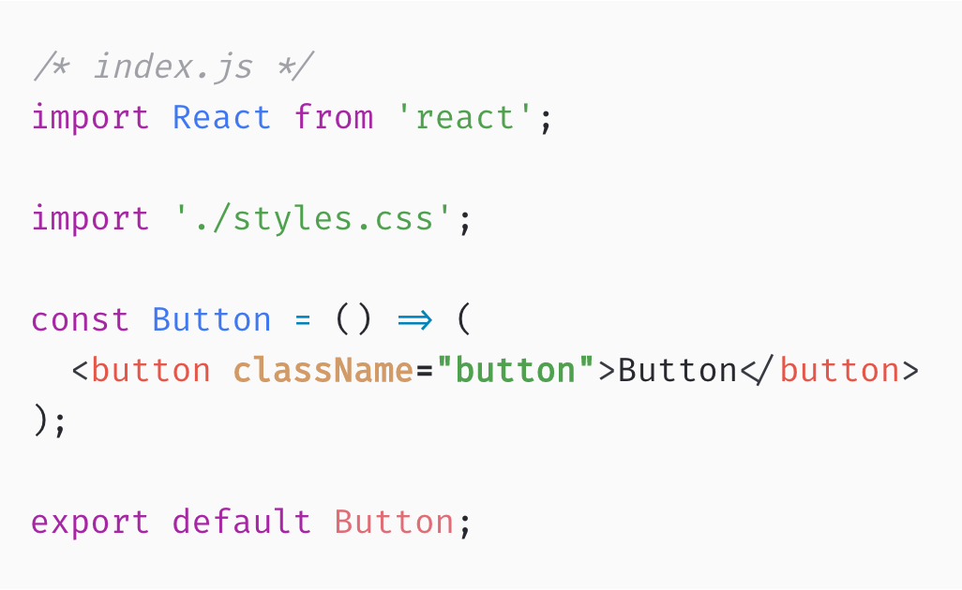
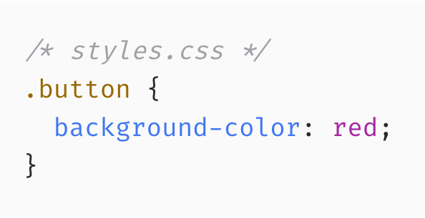
CSS Imports

Slide 22
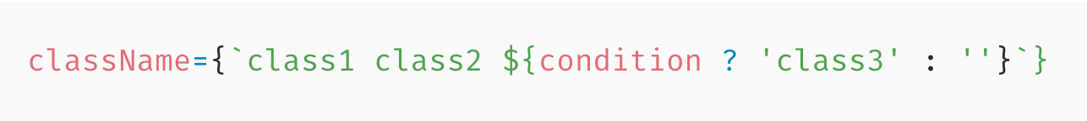
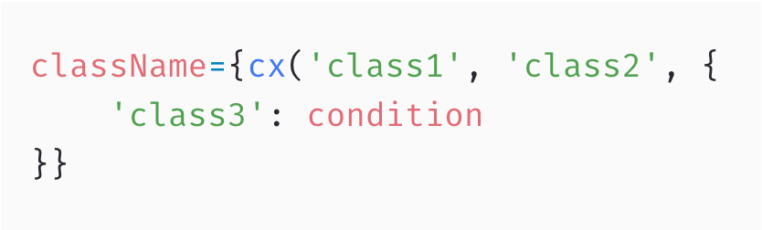
Joining Multiple Classes
className attribute accepts string values
we should use string concatenation to join multiple classes:
ES6 template literals
classnames

Slide 23
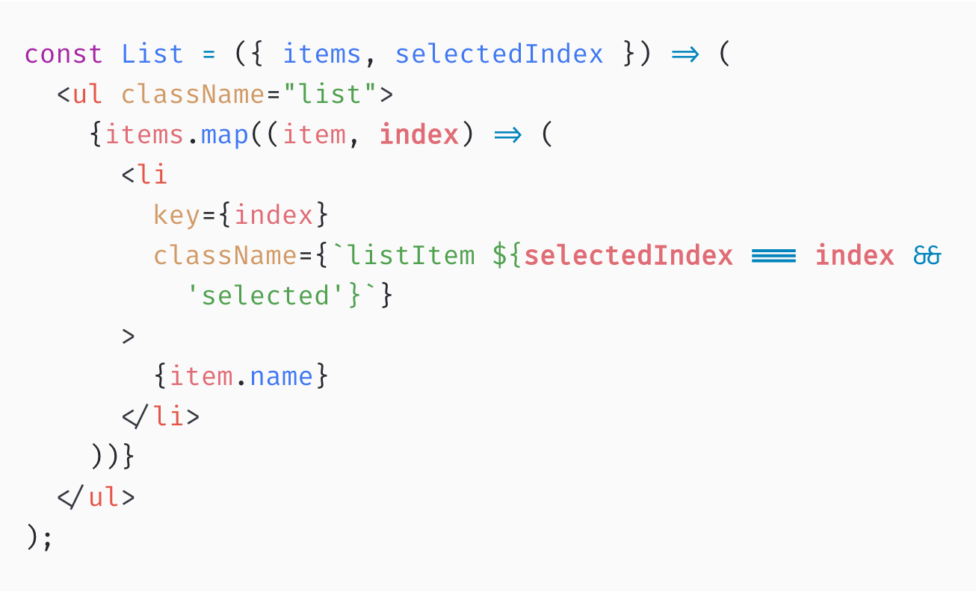
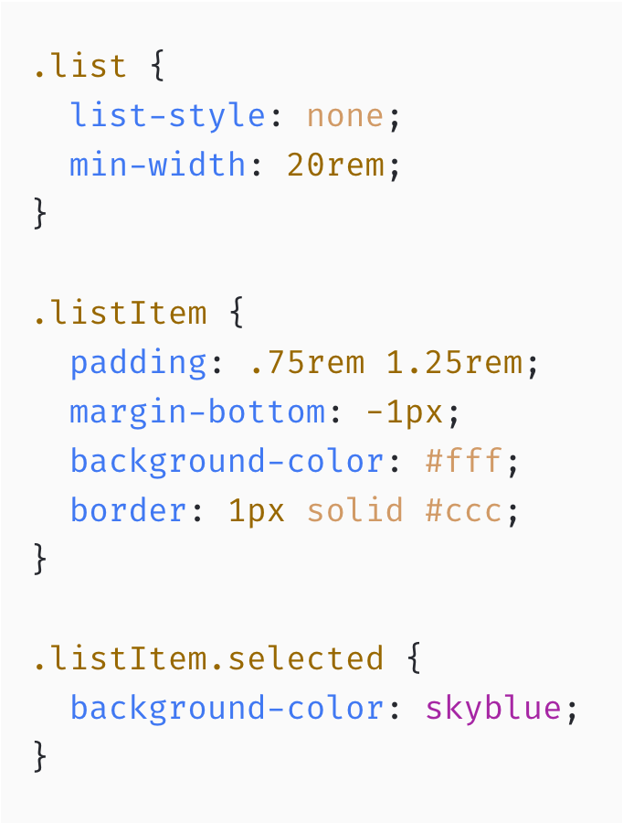
ES6 Template Literal

Slide 24
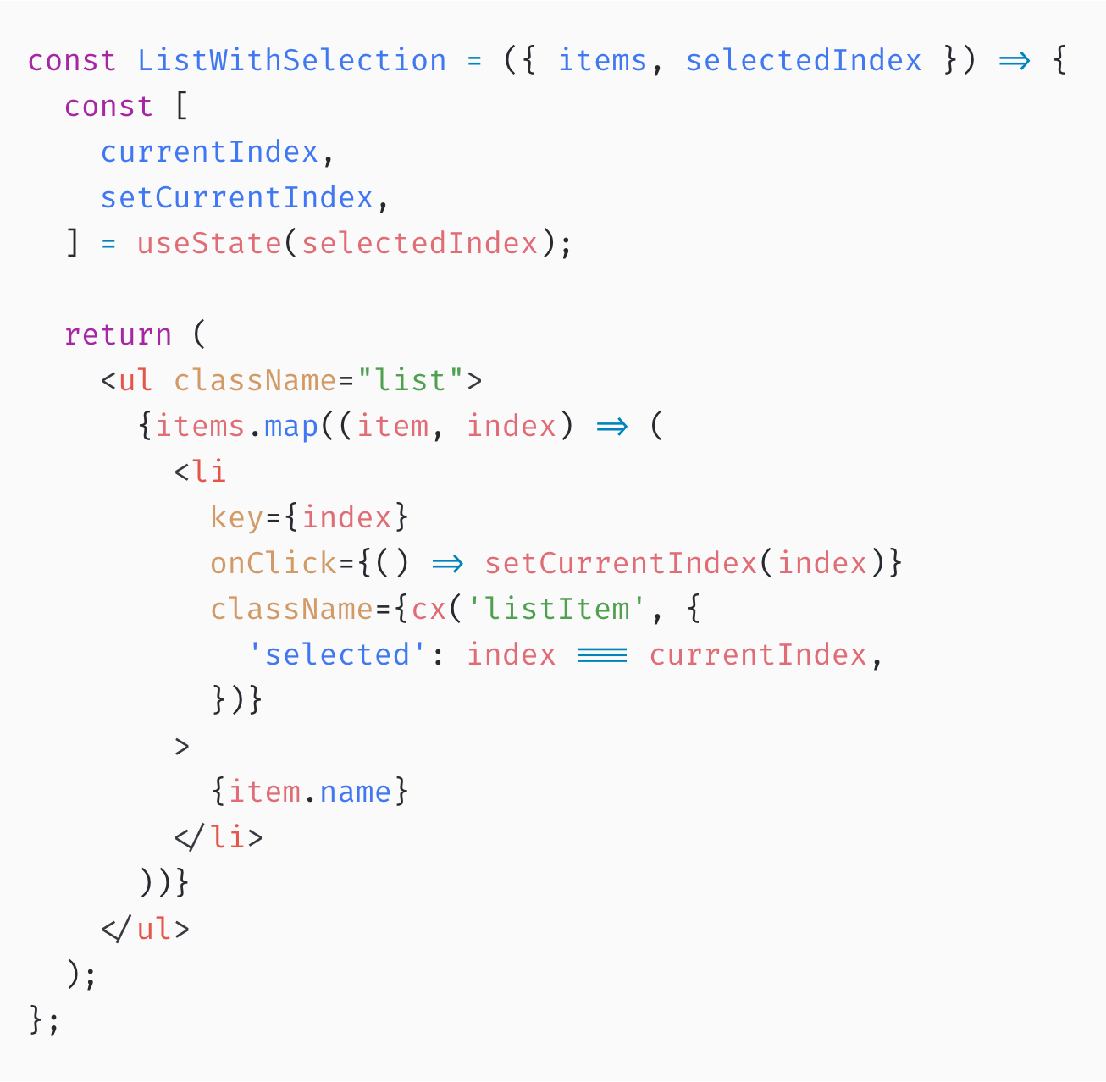
Using `classnames` Library

Slide 25
Adding SASS Support
available in react-scripts@2.0.0 and higher
steps to use it:
install node-sass
change file extension from .css to .scss
change any imports in the .js file to use .scss

Slide 26
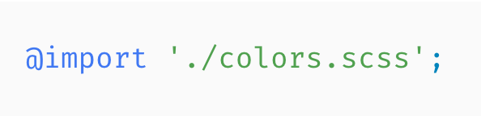
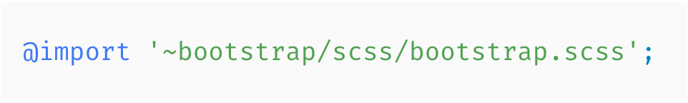
Importing SASS Files
partial .scss files must start with _
Import .scss files to reuse variables, functions, mixins:
You must prefix imports from node_modules with ~:

Slide 27
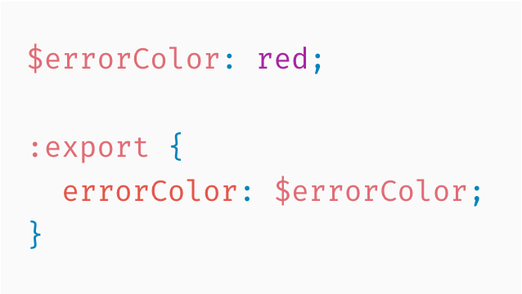
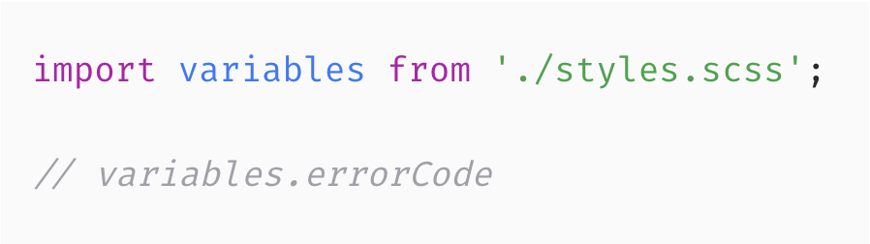
Exporting SASS Variables
share variables between .js and .scss files
using the :export directive

Slide 28
DEMOS

Slide 29
Good Practices!
separate .css file imports with an empty line
place the .css file in the same folder, next to the component/container file. Import it in the .js file
use unique class names, naming conventions
don’t reuse same CSS classes across different components
import any third party or common/global styles in index.js
use classnames library for conditionally joining class names together or/and ES6 template literal syntax

Slide 30
CSS Modules

Slide 31
CRA - Built-In Support
available in react-scripts@2.0.0 and higher
steps to use it:
change file extension from .css to .module.css
change any imports in the .js file to use .module.css
use the imported object to assign class names
unique class names (no more global scope issues)
[filename]\_[classname]\_\_[hash]

Slide 32
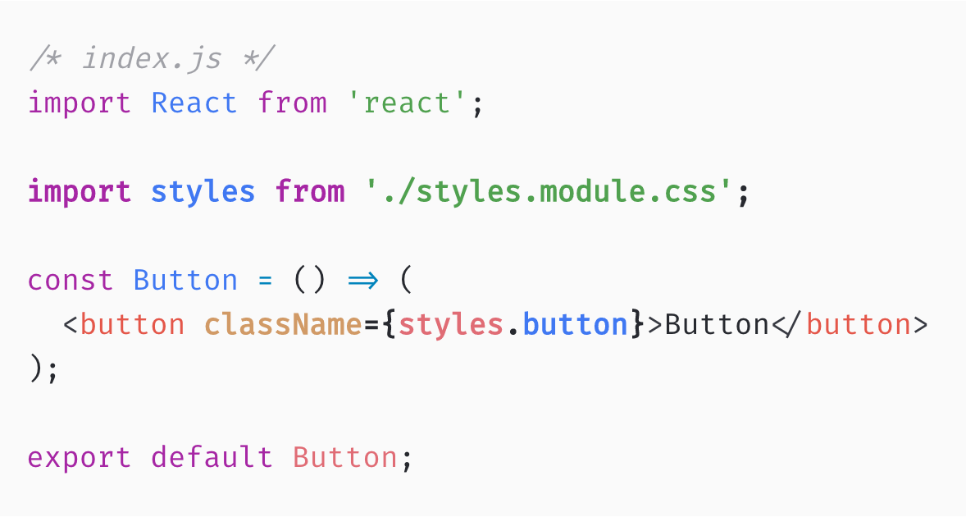
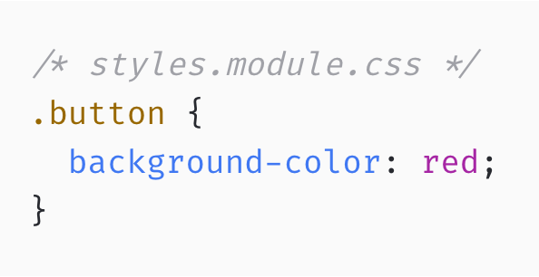
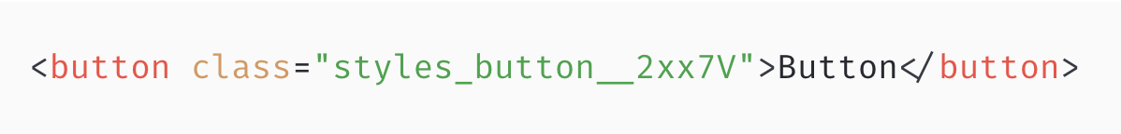
Importing CSS Modules

Slide 33
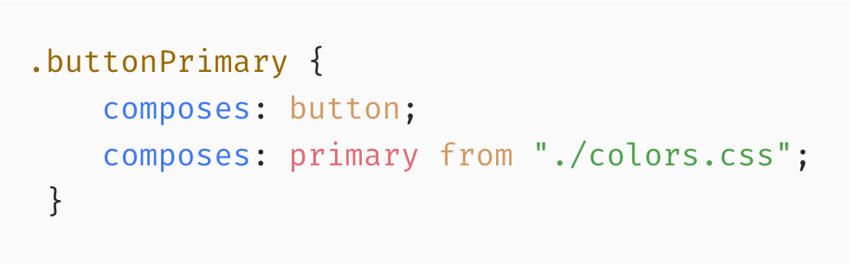
Other Features
variables supported with:
@value primary: skyblue;
composes is the official way to extend classes
SASS support

Slide 34
DEMOS

Slide 35
Good Practices!
use camelCase instead of kebap-case for the class names. Hyphens (-) don't play nice with JSX!
avoid composing global styles

Slide 36
Inline Styling

Slide 37
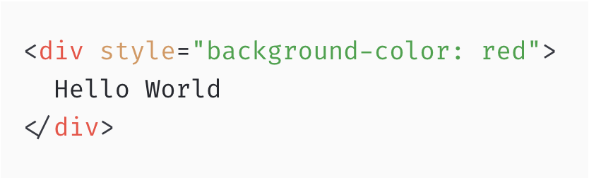
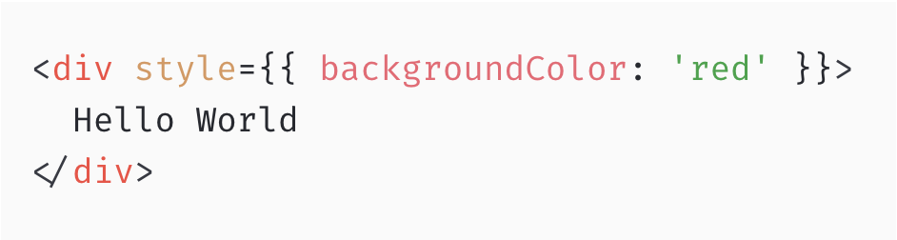
HTML vs JSX

Slide 38
Using the `style` Attribute
pass an object containing CSS properties and values to the style attribute using JSX expression
any CSS property with a hyphen must be converted to camelCase (font-size is typed as fontSize)
property values should be wrapped in quotes - except unitless props like (order, flex, opacity, zIndex etc).

Slide 39
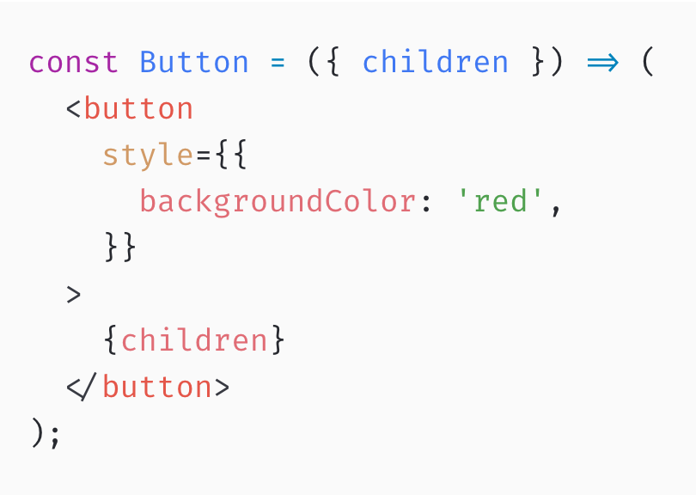
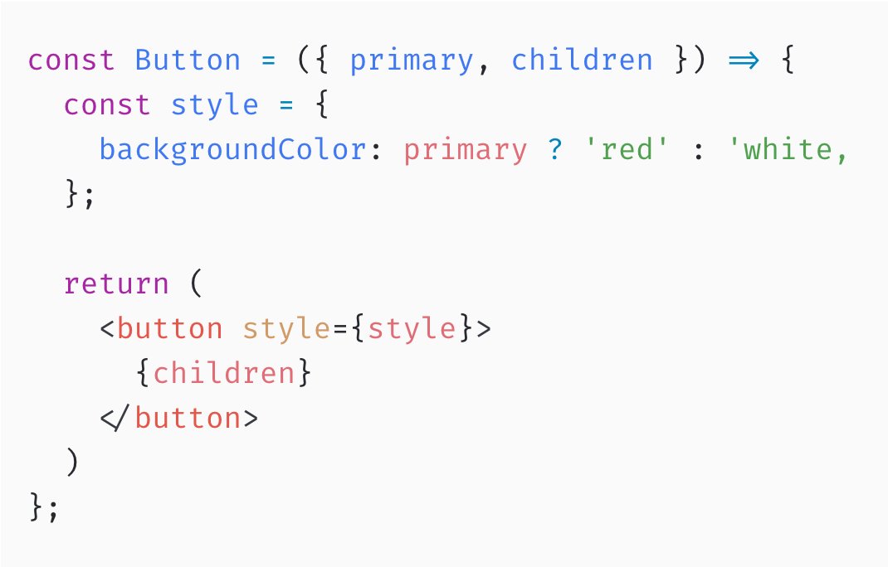
Using Props

Slide 40
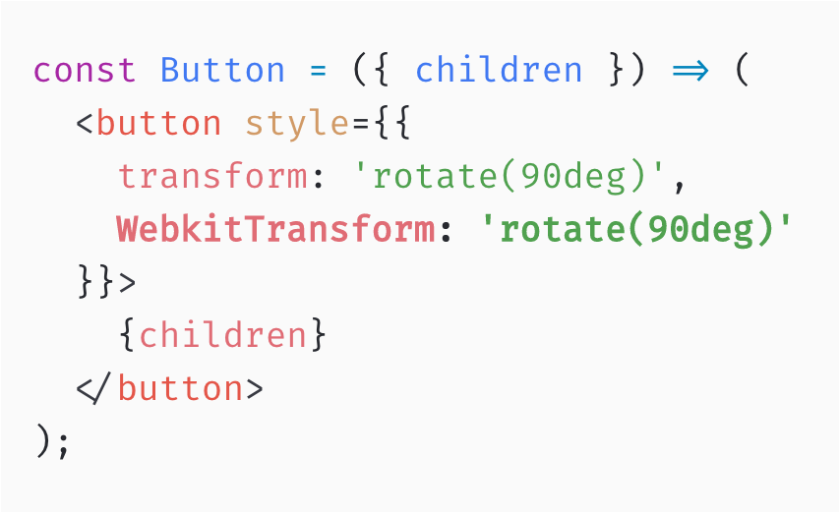
Vendor Prefixing

Slide 41
DEMOS

Slide 42
PROS & CONS
Style is now part of the component
Using the power of JavaScript for styling
Hard to maintain/debug
Lack of CSS support
No automatic vendor prefixing
CSS classes are generally better for performance

Slide 43
CSS in JS

Slide 44
Separation of Concerns

Slide 45

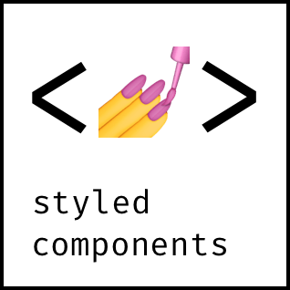





CSS in JS Libraries

Slide 46
Styled Components
https://www.styled-components.com/

Slide 47
Main Features
ES6 tagged template literal
full CSS support (css or object literal syntax)
SASS support (nested styles)
extending styles
automatic vendor prefixing
unique class names
theme provider
testing - JEST integration, snapshots
React Native support

Slide 48
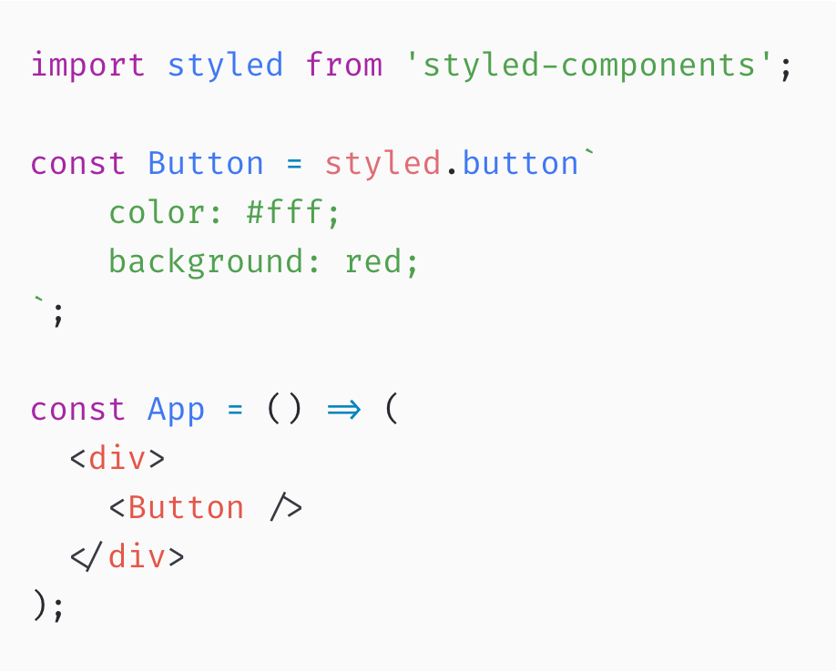
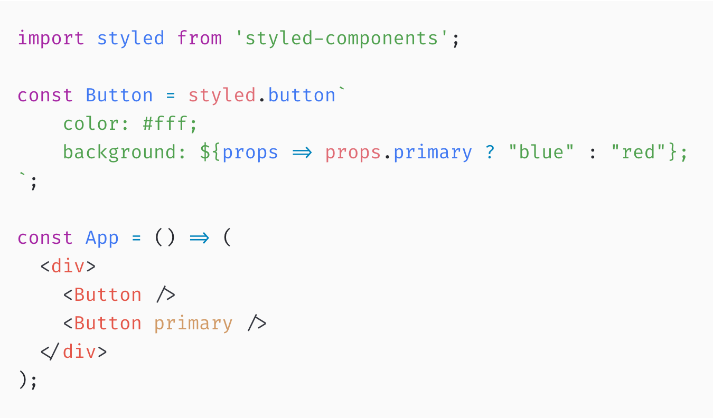
Using Props

Slide 49
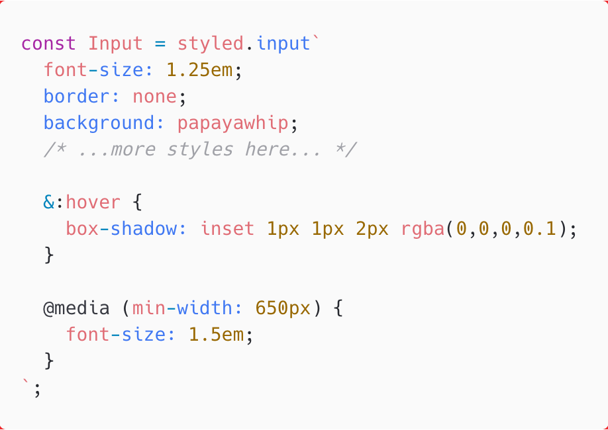
Full CSS Support

Slide 50
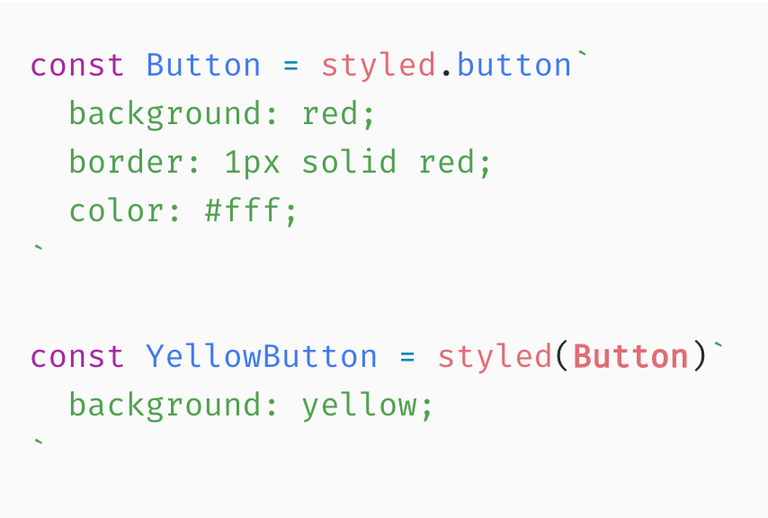
Extending

Slide 51
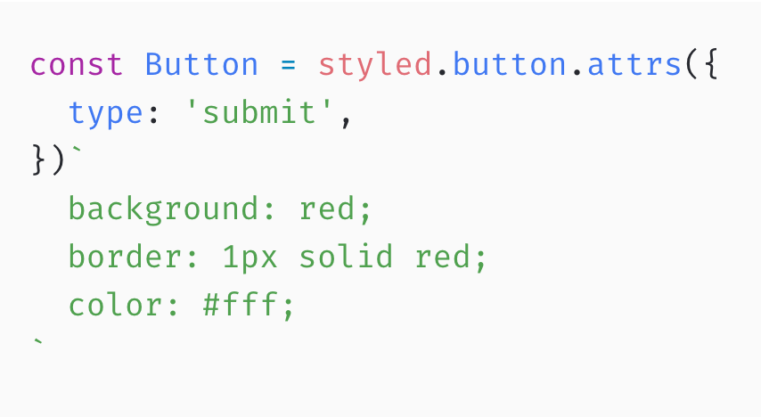
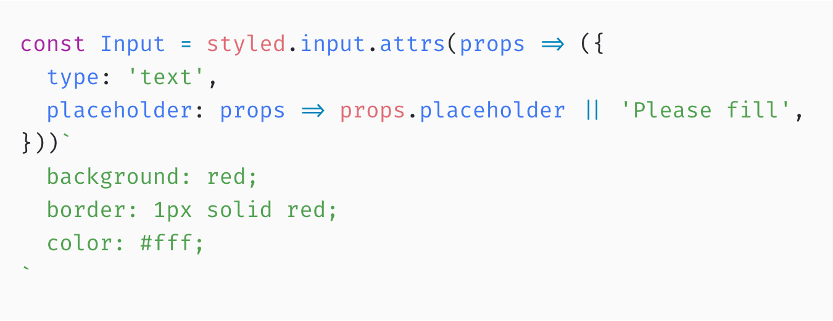
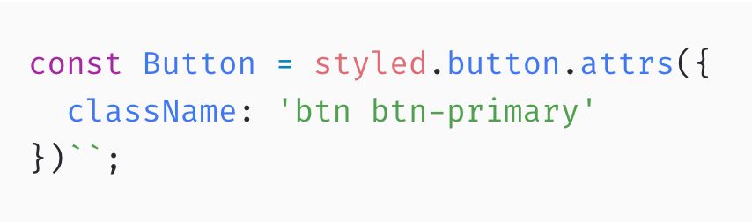
Attaching Props

Slide 52
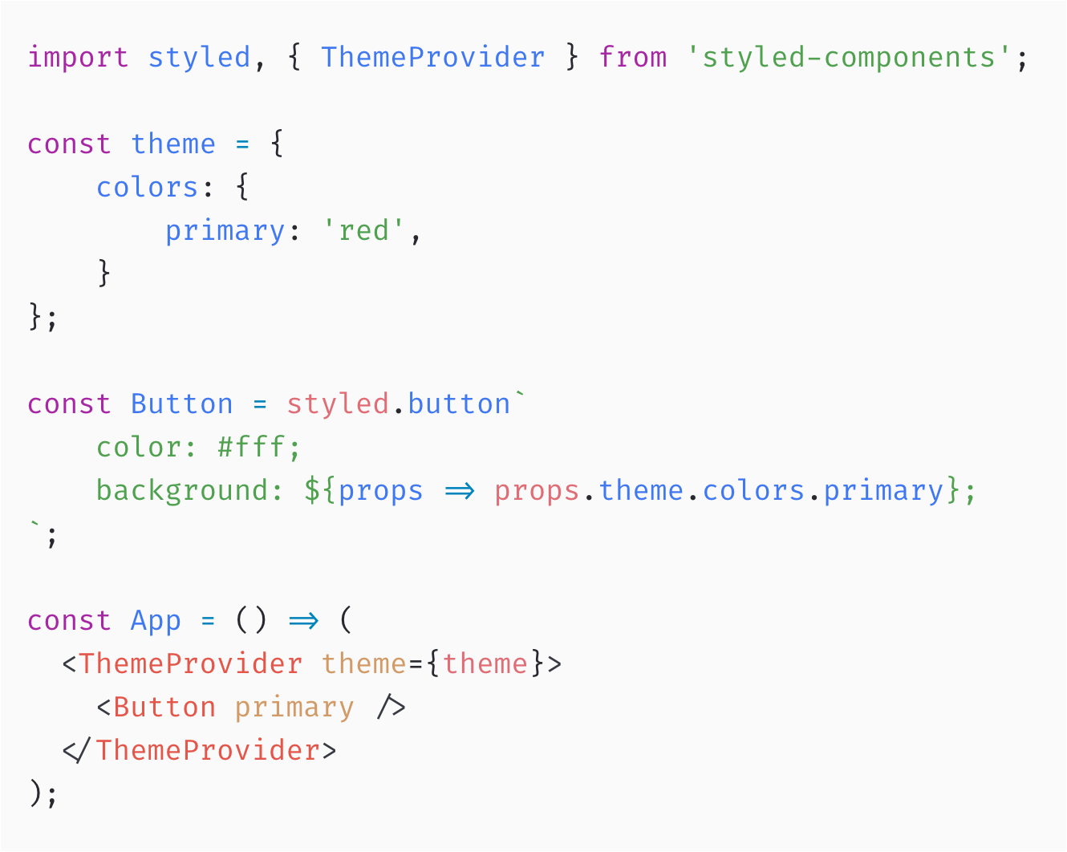
Theme Provider

Slide 53
DEMOS

Slide 54
Good Practices!
use single ThemeProvider for the entire app
keep the templates clean,
use attrs to move the common props definition to the styled component
use attrs and className for integrating with other UI libraries and global class names.
use polished library

Slide 55
React UI Libraries

Slide 56
Articles
React Docs
CSS Modules
CSS in JS Comparison
ES6 Tagged Template Literal
Styled Components - Docs
Styled Components Magic Explained
Reactstrap
Material UI
Rebass

Slide 58






СофтУни диамантени партньори

Slide 59






СофтУни диамантени партньори

Slide 60





Trainings @ Software University (SoftUni)
Software University – High-Quality Education, Profession and Job for Software Developers
softuni.bg
Software University Foundation
http://softuni.foundation/
Software University @ Facebook
facebook.com/SoftwareUniversity
Software University Forums
forum.softuni.bg

